Slide 1
Turbocharging Discovery with Go
Scott Walsh
Senior Threat Intelligence Researcher
Atlantic Security Conference, April 26, 2018

Slide 2
$whoami
Scott Walsh
Senior Threat Intelligence Researcher
I get to search all of the Internet for cool things
Not a great coder
But if I can, so can you!

Slide 3

Again, not a great coder
Notes:
The worst you can do is hurt my feeling. Singular.

Slide 4
Thanks!
Atlantic Security Conference for letting me speak
wget and curl authors
REDACTED for things that I have concerns about as a citizen
SecurityScorecard for hosting the server that I'm about try to melt

Slide 5
Motivation and Goals
Automation is coming for script jockeys
Sometimes scripting languages just aren't enough
Have you ever used Python threading?

Slide 6

Why Go?
Concurrency is core to the language
Toolchain is awesome
Strongly typed
Garbage collected

Slide 7
About Concurrency
Concurrency is running things at the same time
Parallelism and concurrency are not the same thing
Parallelism has concurrency, but the inverse is not true
Synchronization and other overheads are needed
Notes:
Train tracks are parallel- they require certain things to be true.
Lines can be concurrent but aren’t constrained in the same way.

Slide 8
More About Concurrency
Is great if you need unordered results, or can sort after the fact
Plumbed together with chan and goroutines
There are some gotchas, but that’s what this talk is for

Slide 9
Tooling

Slide 10
First, Golang tooling and conventions
Conventions is a bit of a misnomer
“Compiler enforced smackdown” is a better way to think about it.

Slide 11
gofmt
Formats your code
It’s nobody’s favourite coding style
Everybody uses it
It’s very hard to not use it. Editors leverage it heavily
It’s not some half-measure like PEP 8

Slide 12
goimports
A superset of gofmt
It imports packages you have referenced
Removes unused packages
Can include the wrong package if you have multiple packages with the same name
Think of package forks. ASCII-betical first match wins

Slide 13
go get
Package fetcher
go get -u github.com/golang/dep/cmd/dep

Slide 14
go dep
Dependency manager
Will fetch all the imports you need to build
dep ensure
Builds dependency files so you don’t have to include all your imports statically
dep init

Slide 15
dep - there’s more...
Generates Gopkg.toml and Gopkg.lock
Will fetch all the imports you need to build
dep ensure
Builds dependency files so you don’t have to include all your imports statically
dep init

Slide 16
dep- the end.
Is considered an “official experiment”, but it’s the way forward. Investing in learning glide would be a bad use of time
If you use it without version locking, you won’t get reproducible builds

Slide 17
Conventions enforced as standards
Variables and functions that are lower case are private.
You won’t ever see package.function()
This includes struct, and most editors will warn you about the impending bad time that you will have

Slide 18
Conventions enforced as standards
Unused variables will be flagged and halt compilation
You can leave uncalled functions in code without issue

Slide 19
Channels
Pipes of types!
Can have directionality enforced
Read-only and write-only
They are blocking if used in certain way- which we shall avoid like the plague

Slide 20
A Story...

Slide 21
A story...
I wasn't excited to try and explain why I thought Golang was so cool
I had lots of reasons, they were all just disjointed
The FOIPOP incident happened
... and I had an idea

Slide 22
FOIER
Free Online Information EverywheRe
Available now
github.com/invisiblethreat/foier
Bacronyms are fun

Slide 23
FOIER
Concurrent file fetcher
Based on fetching monotonically increasing IDs
Which is horrible design!
It's a learning tool, written just for this talk!
Rip it apart, make it your own

Slide 24
DEMO
(This could totally work…)

Slide 25
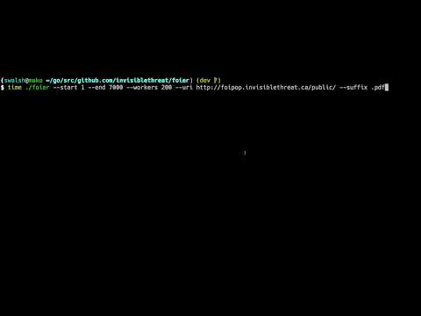

Slide 26

Running FOIER
./foier -h Usage of ./foier: -d, --debug Use debug mode -e, --end int End ID (default 7000) -i, --increment int Increment between steps (default 1) -s, --start int Starting ID --suffix string Suffix of the file you're downloading -u, --uri string URI to use for fetching -w, --workers int How many workers to use (default 5)

Slide 27
Running FOIER
./foier -h Usage of ./foier: -d, --debug Use debug mode -e, --end int End ID (default 7000) -i, --increment int Increment between steps (default 1) -s, --start int Starting ID --suffix string Suffix of the file you're downloading -u, --uri string URI to use for fetching -w, --workers int How many workers to use (default 5)

Slide 28
Running FOIER
The arguments are really not that interesting
--workers is really what this talk is all about

Slide 29
Concurrency as Workers
The arguments are really not that interesting
--workers is really what this talk is all about

Slide 30
CODE
(This totally works)

Slide 31
//Comments
The FOIER package is more than 50% comments
This is so you can make it your own!
Read them and build something new!

Slide 32
main.go
The entry point for compilation
No func main(), no binary

Slide 33
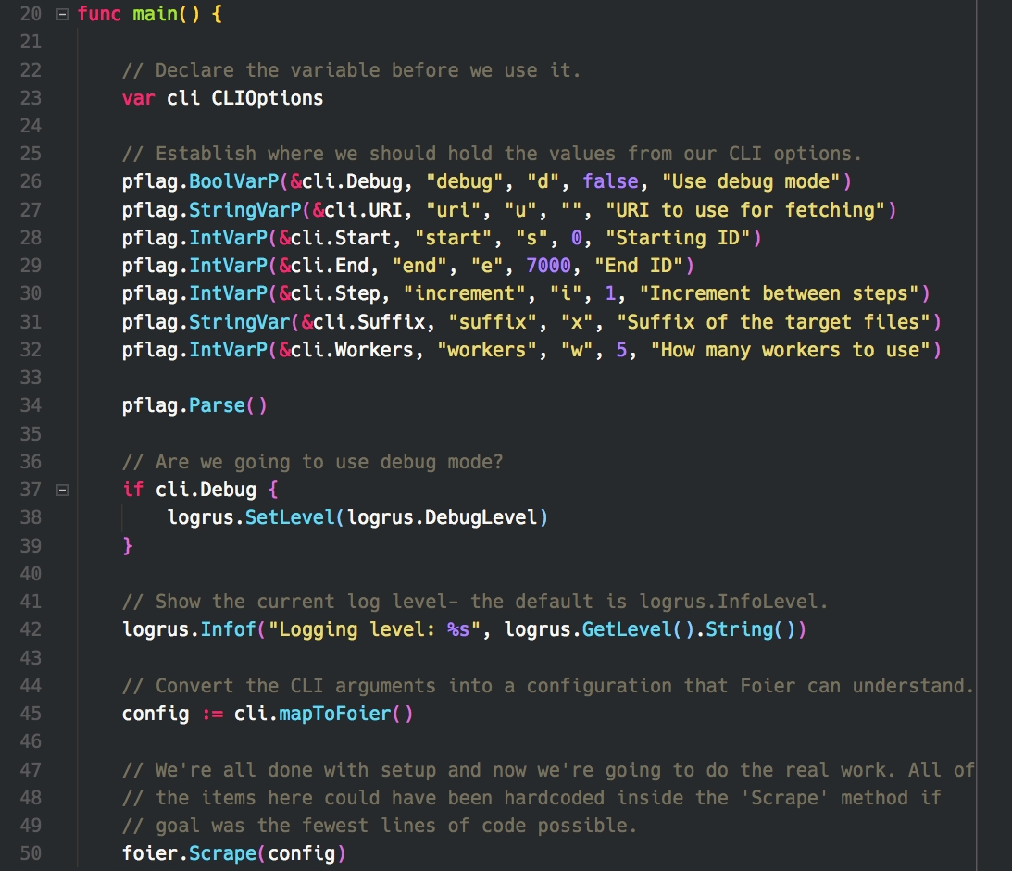

Slide 34
Pointer Receivers- mapToFoier()
Performs an action on a type
A member function by a non-OOP name

Slide 35
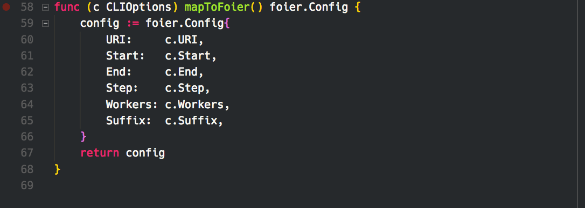

Slide 36
Package Functions - foier.Scrape()
This is where all the good stuff happens!
Functions as the parent for all of our workers

Slide 37
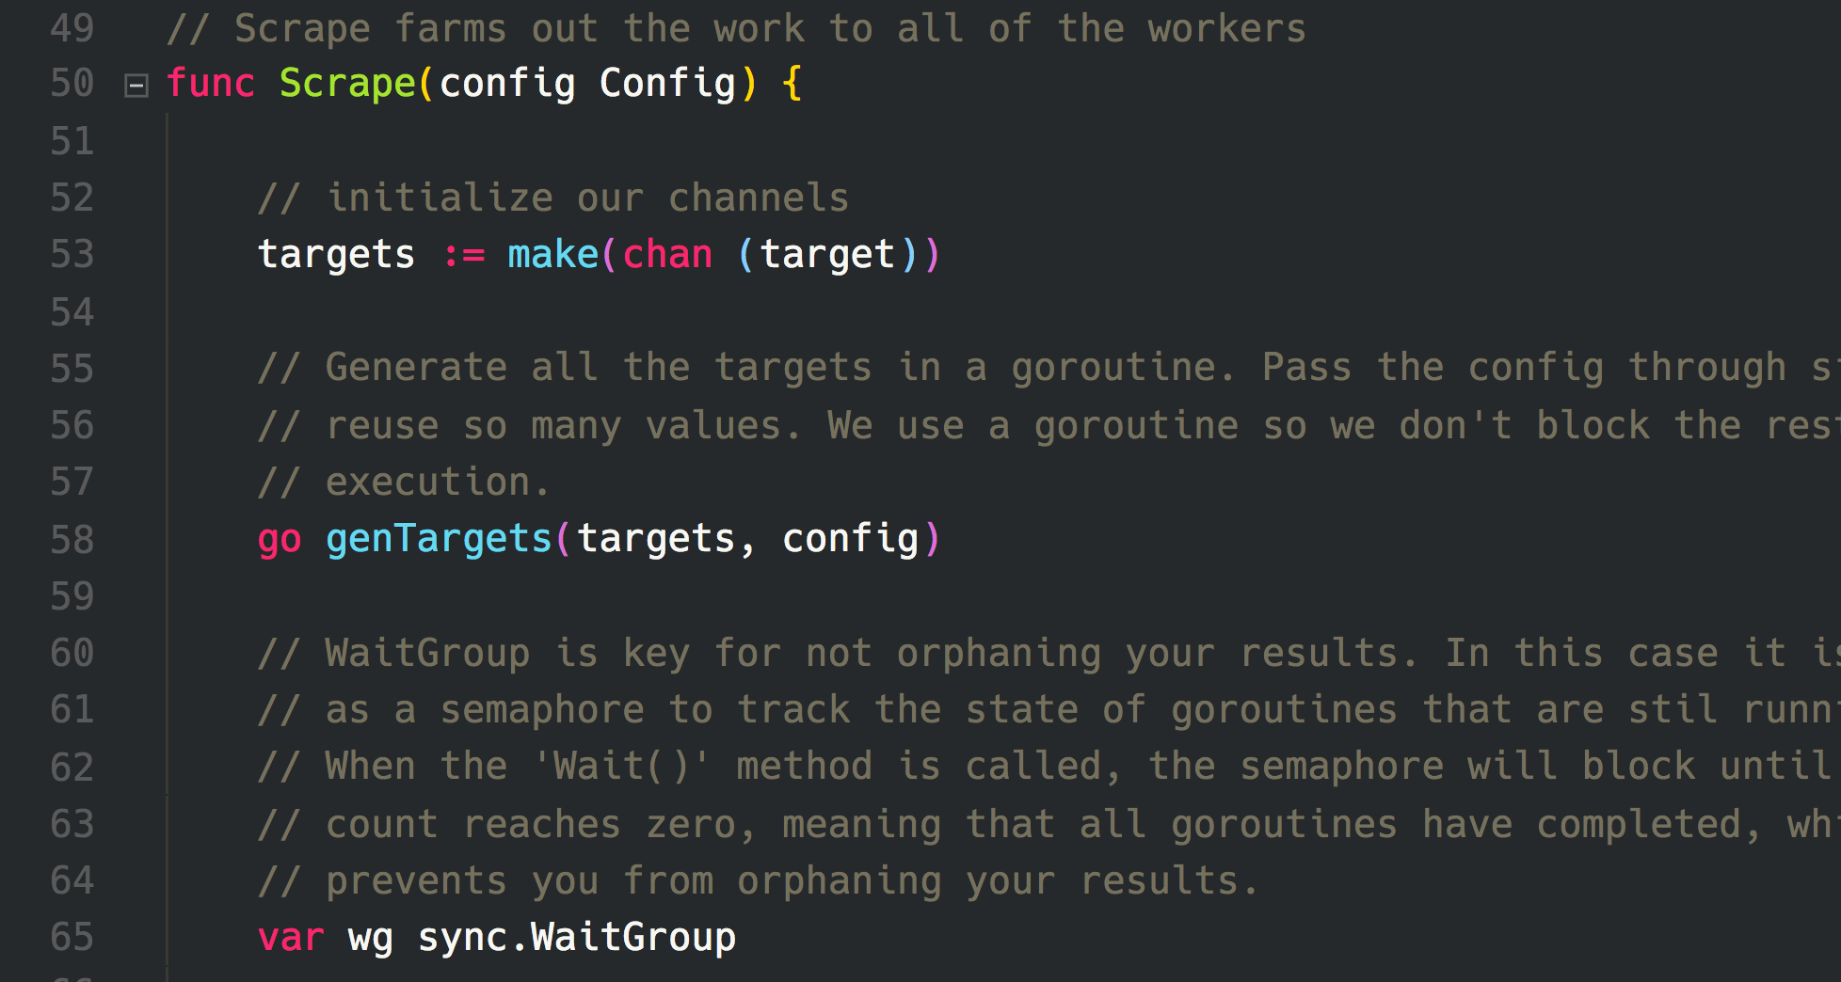

Slide 38
Now for the big reveal!
We’re about to see the equivalent of Apache spawning all of its workers
This is unlocking the power of concurrency

Slide 39
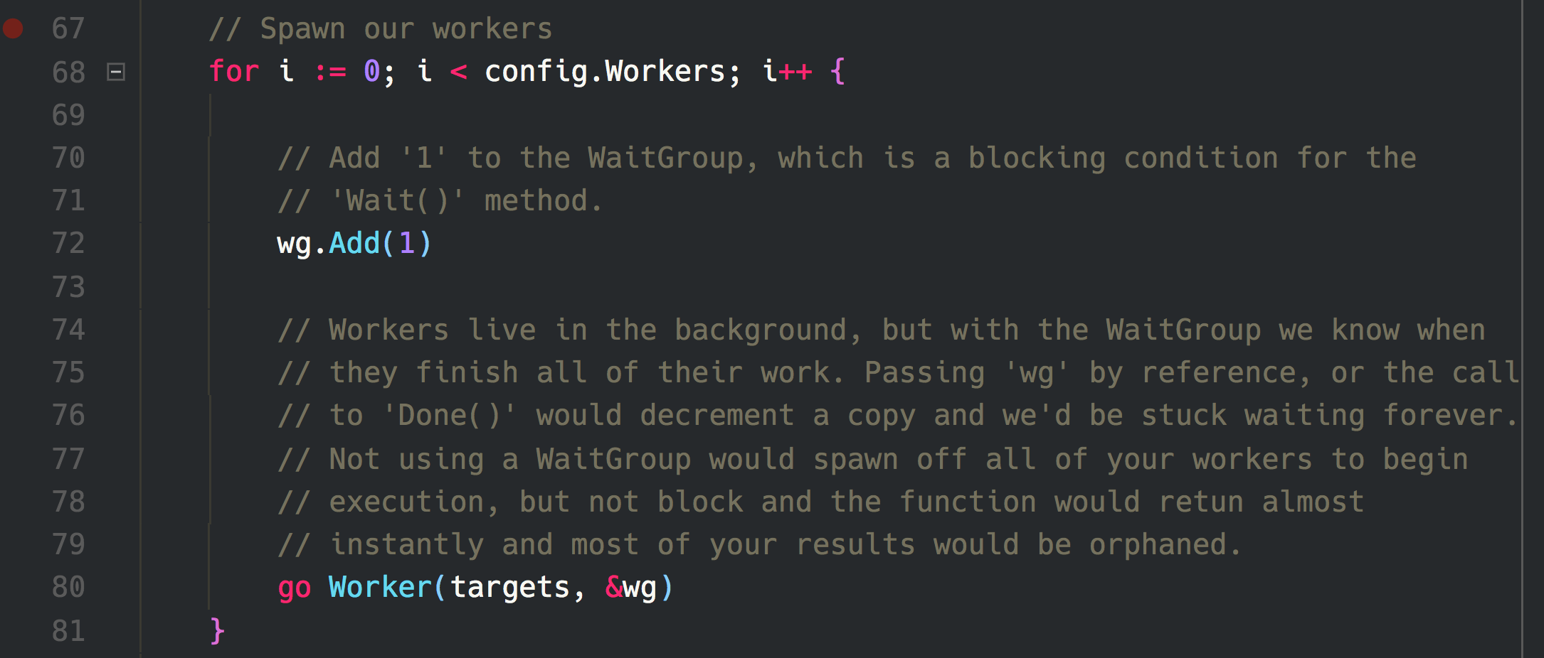

Slide 40
Here be dragons...
Running a demo like I did is deeply abusive and anti-social
Concurrency can get you on a lot of blacklists
API bans galore
Be smart and spread out requests

Slide 41
Q&A

